Slide 1

Central Pacific Hazards Outlooks
Date of Issue: 2025-02-18
Week-1, Valid: 19 – 25 February 2026

Slide 2
Outline:
Seasonal Drought Indicators and Indices (rainfall, SPI, SPEI, SMP)
Monthly Drought Indicators and Indices (rainfall, SPI, SPEI, SMP)
Weekly Rainfall and Flood Indices (SRI, SPI)
Weekly Temperature Summary
Vegetation Health
Weekly Rainfall and Temperature Forecasts and Drought Forecasts
Monthly NMME Drought Outlook
HFSA Tropical Cyclone Trajectory Forecast
Hazards Outlook

Slide 3
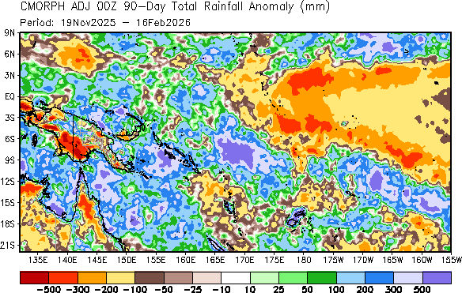
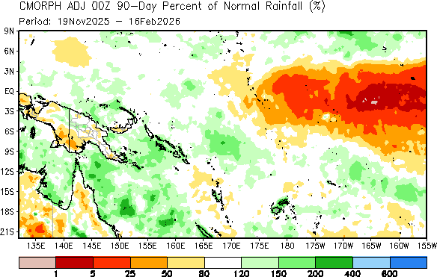
Past 90-day Rainfall Summary
Ninety-day rainfall anomaly (mm, top) and 90-day percent of normal (%, bottom)
Fiji: During December-January-February (DJF) season, the median rainfall contributes 35-40% of the annual total in most of Fiji. During the past 90 days, most of the main islands continued to show large precipitation surpluses. According to the CMORPH-based timeseries analysis, 90-day cumulative surpluses exceeded 1000 mm at some places in Vanua Levu and 500 mm at all interpolated locations in Viti Levu. On the other hand, cumulative precipitation totals were near average or even slightly below average in the northern and southern isolated islands, all of which were within 40 mm of the long-term average precipitation (e.g., Yasawa, Viwa, and Vunisea). In terms of percentages, most of Fiji received 150-200% of the long-term average over the 90-day period, according to the CMORPH satellite-based precipitation analysis.
Kiribati: During DJF, the median rainfall contributes 30-40% of the annual total in most of the Gilbert Islands, Phoenix and Line Islands. During the past 90-day period, cumulative rainfall deficits continued to be substantial and below-average by 80 mm to 240 mm across Kiribati. For most of the stations currently monitored, the main wet events with heavier precipitation occurred in early January and early February 2026. Due to the ongoing dryness, many locations in Kiribati continued to record less than 50% of their long-term average rainfall. Phoenix and the Line Islands received less than 25% of their average.
Papua New Guinea: During DJF, median rainfall contributes 20-30% of the annual total across the mainland of the country, less than 20% of the annual total in New Britain and 40-50% in the southwestern PNG. Over the past 90 days, a substantial deficit (> 300 below average) exists and covers large areas of the southwestern region according to the CMORPH analysis, but deficits are less pronounced (less than 200 mm below average) and limited to small parts of the Southwest in the MSWEP precipitation dataset. There is also some variance between the two data sets in terms of percent of normal, with the MSWEP showing below average (50-80% of normal) precipitation at isolated areas, while the CMORPH indicates much below average precipitation in these areas.
Solomon Islands: During DJF, the median seasonal rainfall accounts for approximately 20-30% of the annual total across the Solomon Islands. CMORPH satellite-derived precipitation interpolated to station locations indicates that, over the past 90-day period, cumulative surpluses remained high as severe storms continued to produce heavy precipitation. Cumulative anomalies exceeded 500 mm in central and northern islands, while surpluses ranging between 100-200 mm in the southern Islands. According to station timeseries interpolated from the CMORPH precipitation data, all 10 locations currently monitored show surpluses, but reaching as high as 600 mm in New Georgia over the 90-day period. In terms of percentages, most stations recorded precipitation totals more than 120% of their long-term climatology.
Vanuatu: Ninety-day cumulative precipitation continued to be large in parts of the northern Islands (Sanma, Penama, and Malampa), where surpluses ranged from 135 mm above average in Penama to 747 mm above average in Malampa. On the other hand, 90-day deficits were large in the far northern (Torba) and far southern (Tafea) islands, where deficits ranged between 230 mm and 70 mm below average for the season.
https://ftp.cpc.ncep.noaa.gov/International/CP_Islands/CMORPH_ADJ_EOD/cmorph_90day_cpi_anom.png
https://ftp.cpc.ncep.noaa.gov/International/MSWEPv2/CP_Islands/MSWEPv2_90day_cpi_anom.png
https://ftp.cpc.ncep.noaa.gov/International/CP_Islands/CMORPH_ADJ_EOD/cmorph_90day_cpi_pnorm.png
https://ftp.cpc.ncep.noaa.gov/International/MSWEPv2/CP_Islands/MSWEPv2_90day_cpi_pnorm.png

Slide 4
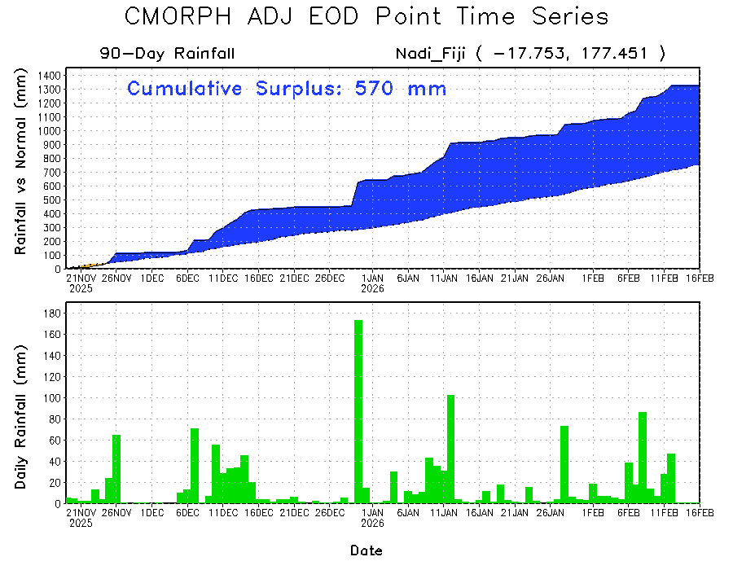
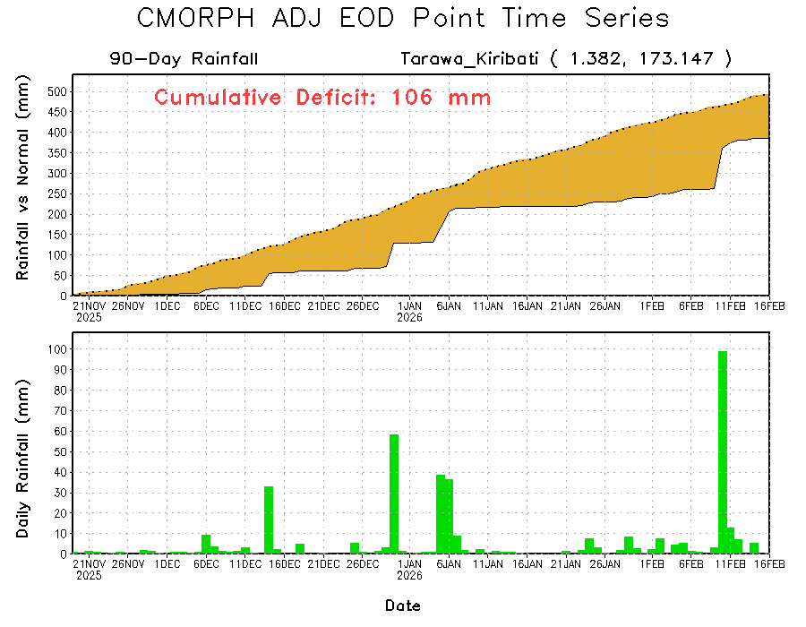
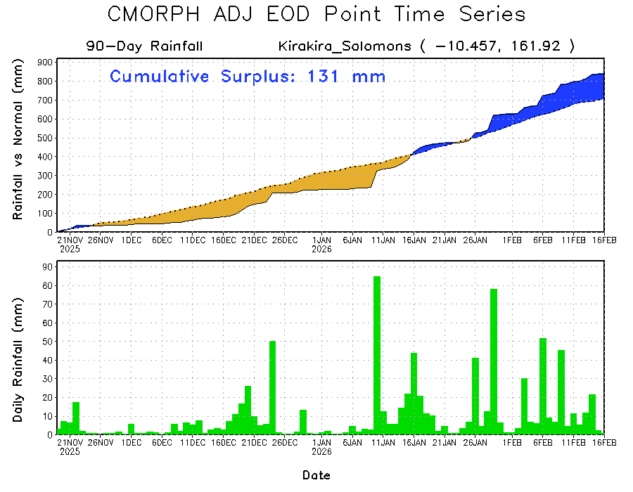
Cumulative Rainfall Evolution in Past 90 days
https://www.cpc.ncep.noaa.gov/products/international/zz_CP_Islands/zz_CMORPH_ADJ_EOD/cmorph_90day_ptts_Nadi_Fiji.gif
https://www.cpc.ncep.noaa.gov/products/international/zz_CP_Islands/zz_CMORPH_ADJ_EOD/cmorph_90day_ptts_Tarawa_Kiribati.gif
Evolution of daily cumulative rainfall
Following the frequent and continuous rainfall since November Nadi's 90-day cumulative rainfall surplus keeps increasing. Nadi currently maintains a large cumulative surplus (top left).
Drier-than-average conditions persisted in the Gilbert Islands despite the recent rainfall events. As a result, primarily dry conditions continued across most of Kiribati (top right). Significant deficits were observed in the other Islands.
Increased precipitation since early January initially diminished the 90-day cumulative deficits, and resulted into surplus at Kirakira. A similar or larger magnitude surplus is also observed in other Islands.
https://www.cpc.ncep.noaa.gov/products/international/zz_CP_Islands/zz_CMORPH_ADJ_EOD/cmorph_90day_ptts_Kirakira_Solomons.gif

Slide 5
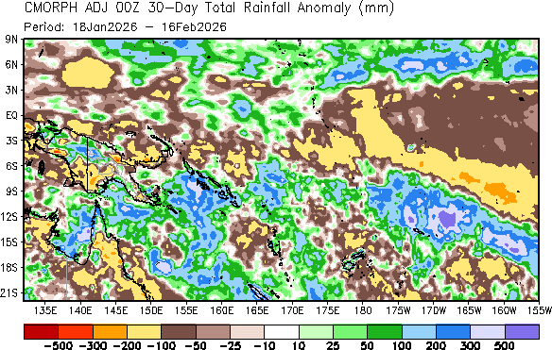
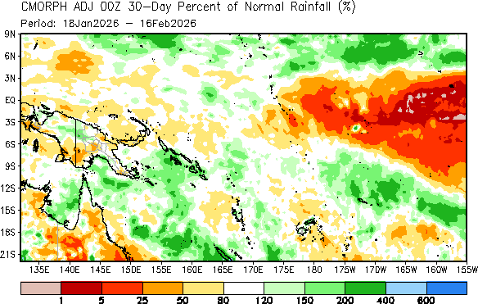
Past 30-day Rainfall Summary
30-day rainfall anomaly (mm, top) and
30-day percent of normal (%, bottom)
Fiji: Climatologically, median monthly precipitation contributes 15–20% of the annual total at most places in February. During the past 30-day period, Fiji experienced notable rainfall surpluses, primarily driven by persistent precipitation between late January and early February. A subsequent lull in rainfall moderated these surpluses toward the latter part of the period. CMORPH satellite-derived precipitation interpolated to station locations indicates that much of Viti Levu and Vanua Levu recorded cumulative surpluses ranging from approximately 70 to 100 mm. In contrast, renewed deficits emerged across the northwestern, eastern, and southern regions following the recent break in rainfall, with mild deficits of roughly 50–100 mm evident over the eastern islands. Overall, the main Islands of Fiji received approximately 80–120% of their climatological monthly mean rainfall during the period.
Kiribati: Climatologically, the monthly median rainfall for February contributes 11–15% over Gilbert and Phoenix Islands, while the Line Islands receive more than 20% of the annual total. Over the past 30-day period, CMORPH satellite-derived precipitation estimates indicate that some stations across the Gilbert and Line Islands recorded cumulative rainfall surplus ranging from approximately 10 to 80 mm. In contrast, shortfalls of up to 80 mm persist at Beru and Canton in the Gilbert and Phoenix Islands. With recent rainfall increase, deficits are reducing in much of Kiribati.
Papua New Guinea: Climatologically, February contributes only 3–7% of annual rainfall in the New Britain, 9–11% across the central highlands, and 13-20% in the southwestern and eastern provinces. Over the past 30 days, cumulative deficits persisted in Morobe, Madang, and the Southern and Western Highlands of Papua New Guinea. According to time-series analysis derived from the CMORPH satellite dataset, cumulative anomalies remained positive in the eastern highlands and the East Spik. On the other hand, drier-than-average conditions persisted at many locations, including Western Highlands (e.g., Mount Hagen) and Madang. In terms of climatological percentages, South Western Papua New Guinea received about 25–80% of its long-term average rainfall.
Solomon Islands: Climatologically, this period accounts for 9–15% of annual rainfall in the Solomon Islands. Due to ongoing rainfall, most of the Solomon Islands recorded rainfall surpluses over the past 30 days. According to time-series analysis of CMORPH satellite data, locations in the Western (Gizo), New Georgia (e.g., Munda), and Guadalcanal (e.g., Honiara) recorded cumulative surpluses exceeding 250 mm above average. The lowest surplus of 105 mm above-average was recorded at KiraKira. Overall, the central islands received more than 200% of their long-term average rainfall.
Vanuatu Over the past 30 days, the magnitude of surpluses of precipitation decreased to less than 140 mm (above average) in the central regions, including Sanma and Malampa.
https://ftp.cpc.ncep.noaa.gov/International/CP_Islands/CMORPH_ADJ_EOD/cmorph_30day_cpi_anom.png
https://ftp.cpc.ncep.noaa.gov/International/MSWEPv2/CP_Islands/MSWEPv2_30day_cpi_anom.png
https://ftp.cpc.ncep.noaa.gov/International/CP_Islands/CMORPH_ADJ_EOD/cmorph_30day_cpi_pnorm.png
https://ftp.cpc.ncep.noaa.gov/International/MSWEPv2/CP_Islands/MSWEPv2_30day_cpi_pnorm.png

Slide 6
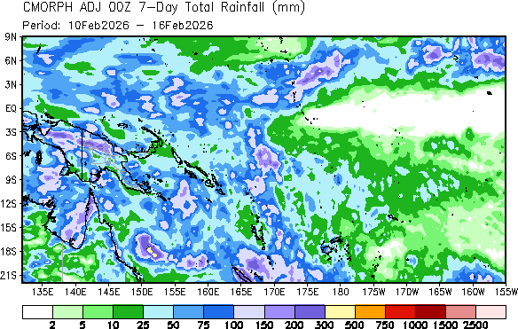
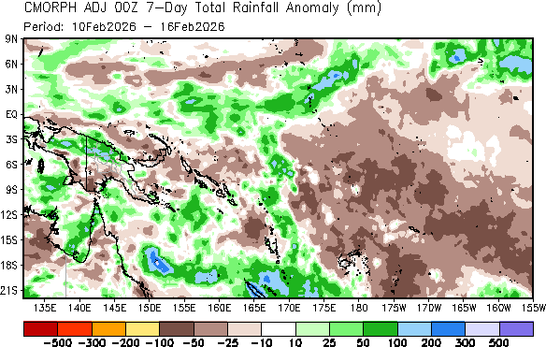
Past 7-day Rainfall Summary
7-day rainfall total (mm, top) and
7-day rainfall anomaly (%, bottom)
Fiji: Light to moderate rainfall was observed across Fiji, with infrared imagery showing several moderately intense systems approaching early last week. Despite this, all Islands now exhibit slight precipitation deficits of 10–50 mm, with the largest deficit over Vanua Levu, as indicated by both CMORPH and MSWEP analyses.
Kiribati: Last week, the northern Gilbert Islands received moderate rainfall from several scattered, short-lived storms during 10th of January, after that, mostly clear skies prevailed across the rest of Kiribati. CMORPH and MSWEP analyses indicate that northern Kiribati and the Line Islands received above-average rainfall, resulting in a surplus of 25–100 mm across the regions.
Papua New Guinea: Late in the week, several intense storms developed over northern, southern, and eastern PNG, producing heavy rainfall of up to 200 mm across the northern and localized regions of gulf area in southern PNG. New Ireland and New Britain also experienced moderate precipitation. CMORPH satellite estimates indicate weekly rainfall deficits exceeding 50 mm in southwestern areas, with localized regions experiencing even larger shortfalls.
Solomon Islands: Mid-week storms passed over the southern Solomon Islands, bringing moderate rainfall exceeding 25 mm to San Cristobal, Malaita, and Guadalcanal, according to CMORPH and MSWEP estimates. Moderate rainfall in the northwestern islands led to drier conditions, with deficits of 10–50 mm.
https://ftp.cpc.ncep.noaa.gov/International/CP_Islands/CMORPH_ADJ_EOD/cmorph_7day_cpi_obs.png
https://ftp.cpc.ncep.noaa.gov/International/MSWEPv2/CP_Islands/MSWEPv2_7day_cpi_obs.png
https://ftp.cpc.ncep.noaa.gov/International/CP_Islands/CMORPH_ADJ_EOD/cmorph_7day_cpi_anom.png
https://ftp.cpc.ncep.noaa.gov/International/MSWEPv2/CP_Islands/MSWEPv2_7day_cpi_anom.png

Slide 7
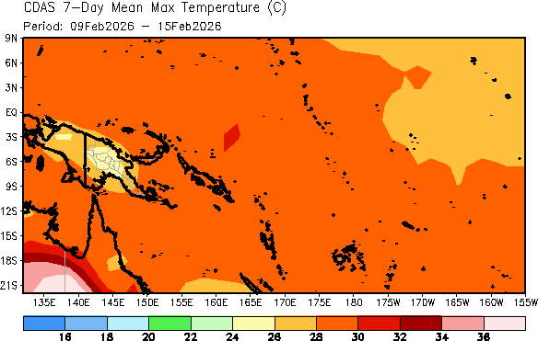
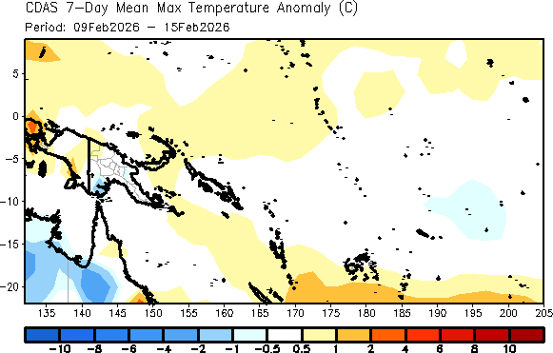
7-day Maximum Temperature
According to the NCEP/NCAR Climate Data Assimilation System (CDAS), temperatures across most of Papua New Guinea ranged from 24–28°C, while warmer temperatures of 28–30°C were observed in New Britain, New Ireland, and southwestern Papua New Guinea (PNG), the Solomon Islands, Vanuatu, most of Kiribati, and Fiji.
https://ftp.cpc.ncep.noaa.gov/International/CDAS_T2max_T2min/T2max/7day/cdas_7day_cpi_Tmax2m_obs.png
According to the NCEP/NCAR CDAS reanalysis, maximum temperatures were 0.5–1°C above average in New Britain and New Ireland of Papua New Guinea, Vanuatu, and the Gilbert Islands. Near average temperature was observed in Fiji, northern Vanuatu, and the Phoenix Islands of Kiribati.
https://ftp.cpc.ncep.noaa.gov/International/CDAS_T2max_T2min/T2max/7day/cdas_7day_cpi_Tmax2m_anom.png

Slide 8
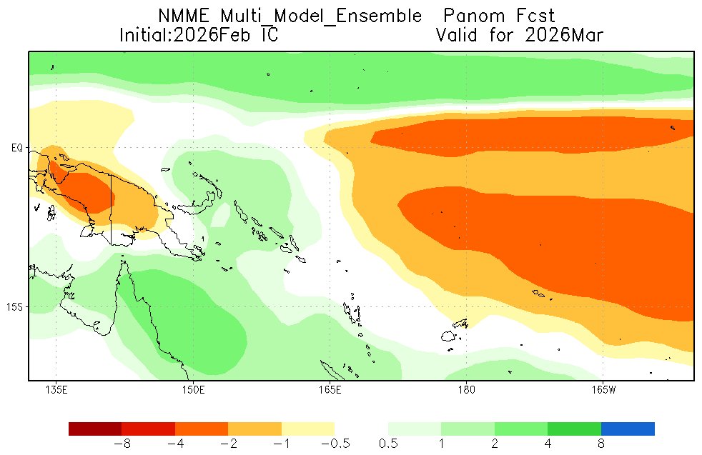
NMME Multi-model 1-month Lead Rainfall Forecast
Ensemble Anomaly
https://www.cpc.ncep.noaa.gov/products/international/drought/nmme/Multi_Model_Ensemble_Panom_L1_PacificIslands.png
NMME forecasts for March 2026 indicate drier-than-average conditions in western Papua New Guinea (PNG) and Kiribati. Wetter condition are predicted in the eastern islands of Papua New Guinea, most of the Solomon Islands and parts of Vanuatu. Near-average rainfall is expected in Fiji.

Slide 9
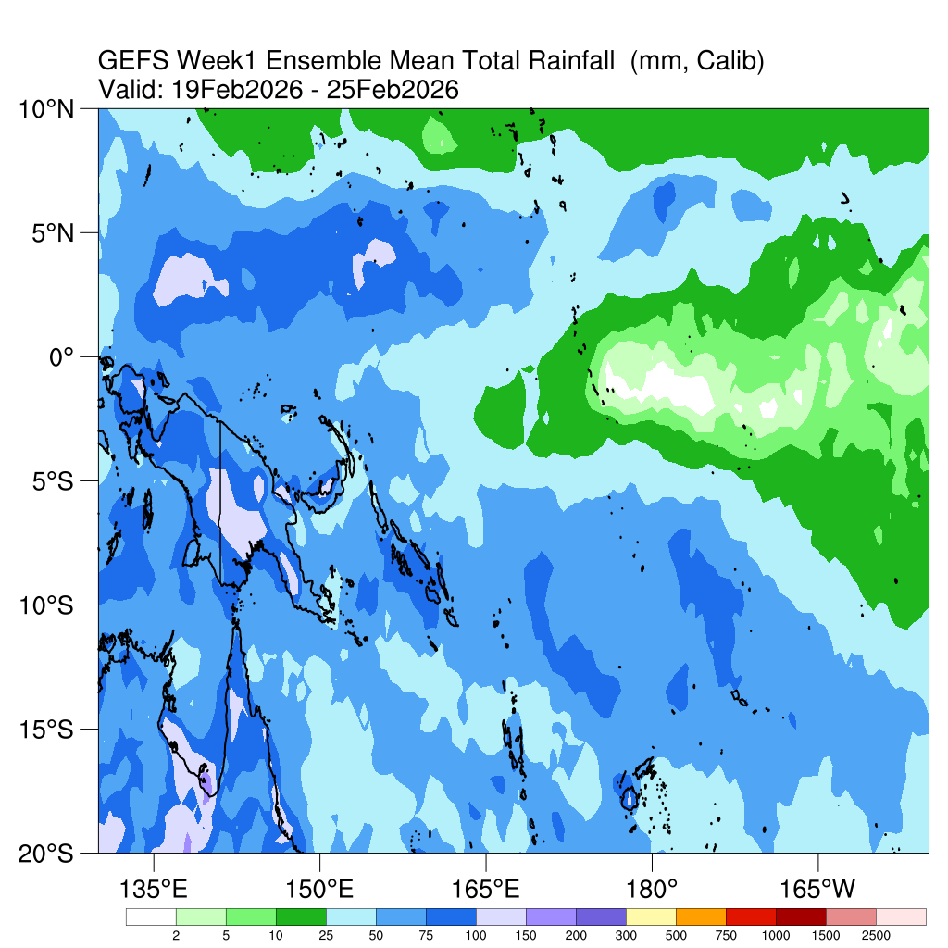
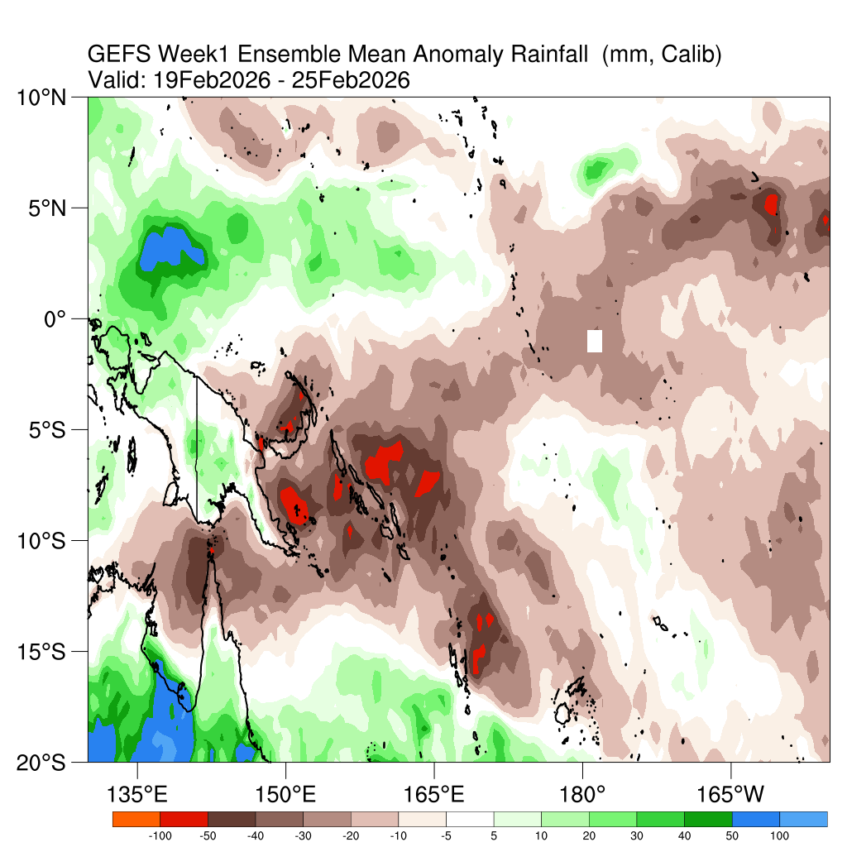
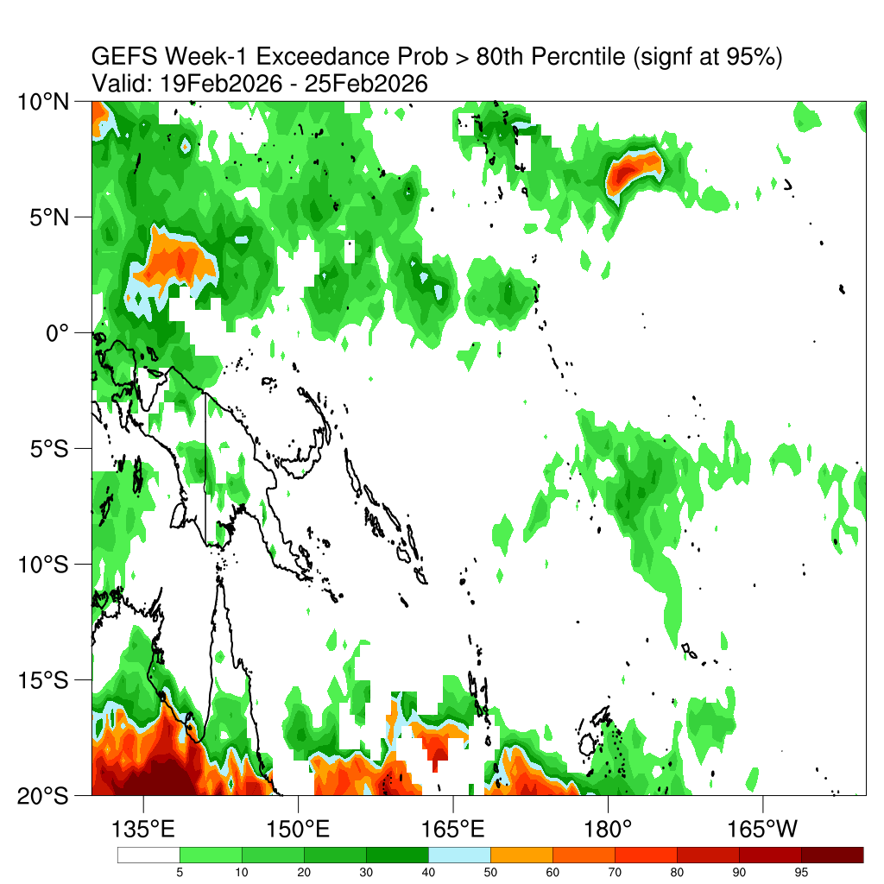
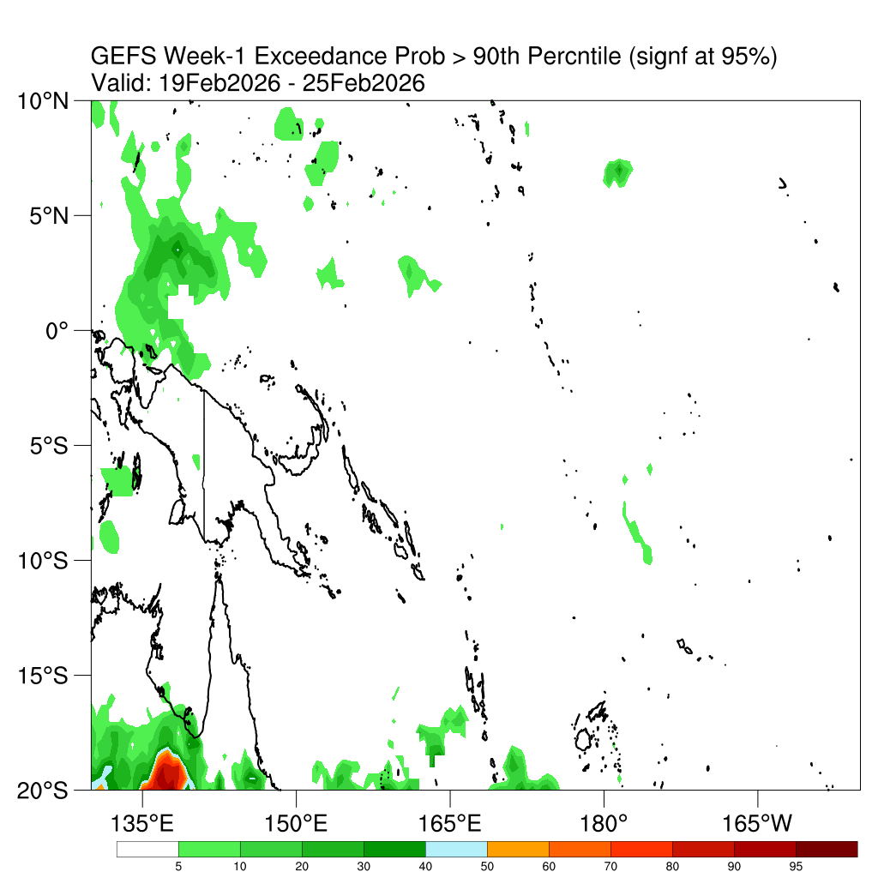
Week-1 GEFS Precipitation/Probability Forecasts (Calibrated)
Rainfall Total (mm)
Rainfall Anomaly (mm)
Precipitation
https://ftp.cpc.ncep.noaa.gov/International/GEFS/cPacific/precGEFSwk1EnsMeanCalib.png
https://ftp.cpc.ncep.noaa.gov/International/GEFS/cPacific/precGEFSwk1AnomCalib.png
PoE for precip exceeding the 80th percentile
PoE for precip exceeding the 90th percentile
Probability of Exceedance (PoE)
https://ftp.cpc.ncep.noaa.gov/International/GEFS/cPacific/wk1precExcd80sig.png
https://ftp.cpc.ncep.noaa.gov/International/GEFS/cPacific/wk1precExcd90sig.png

Slide 10
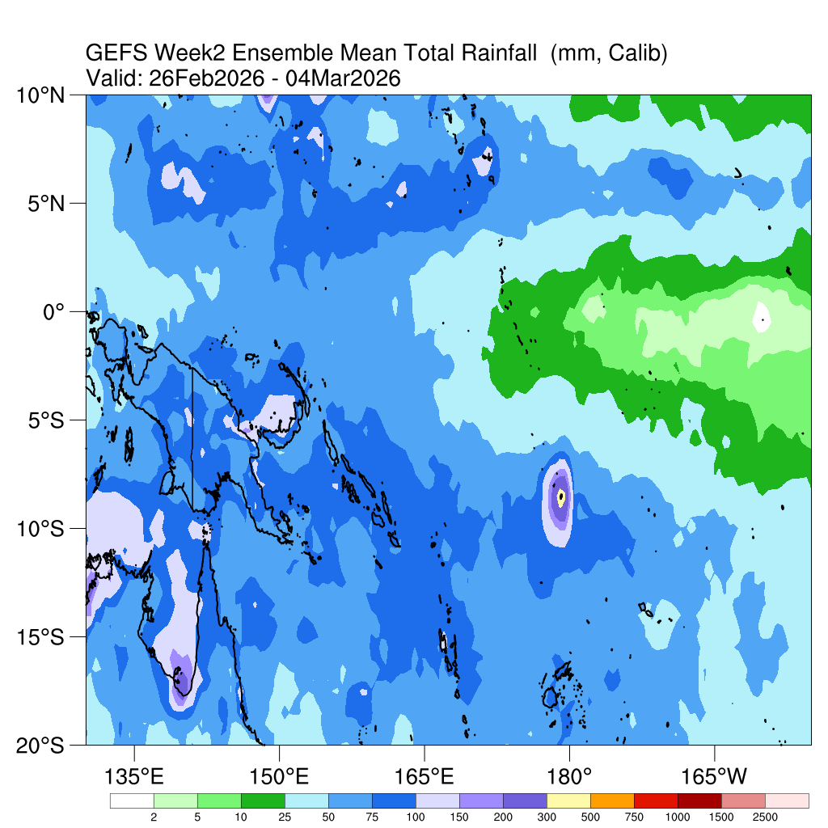
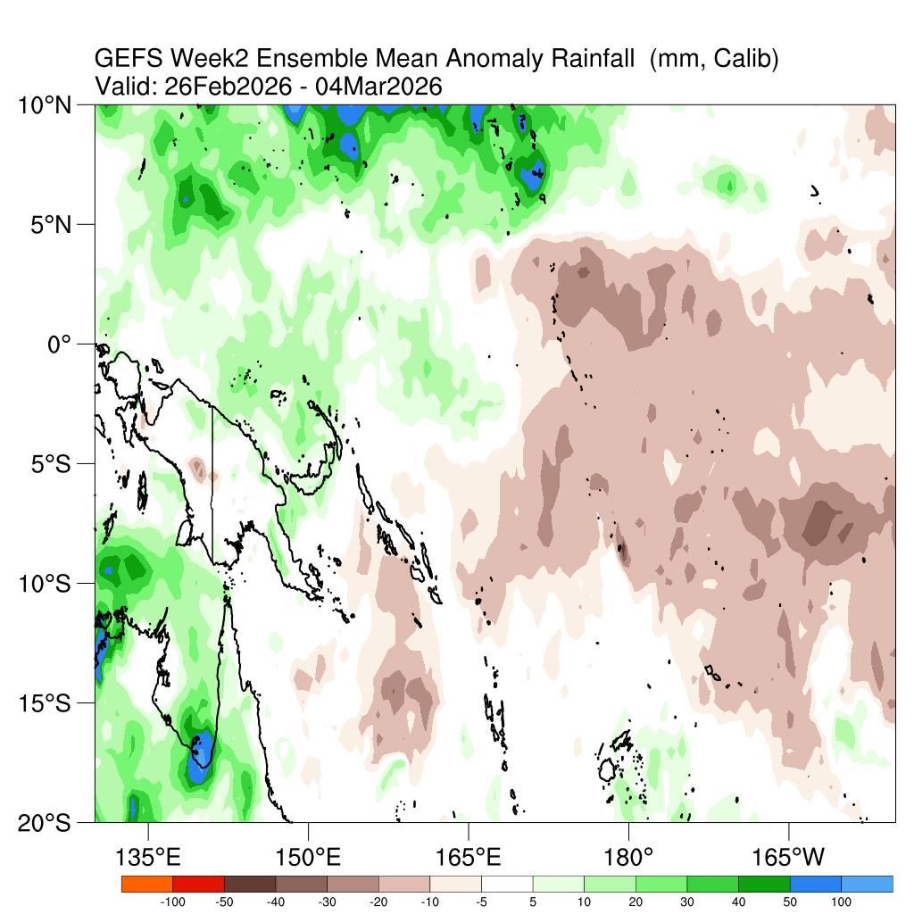
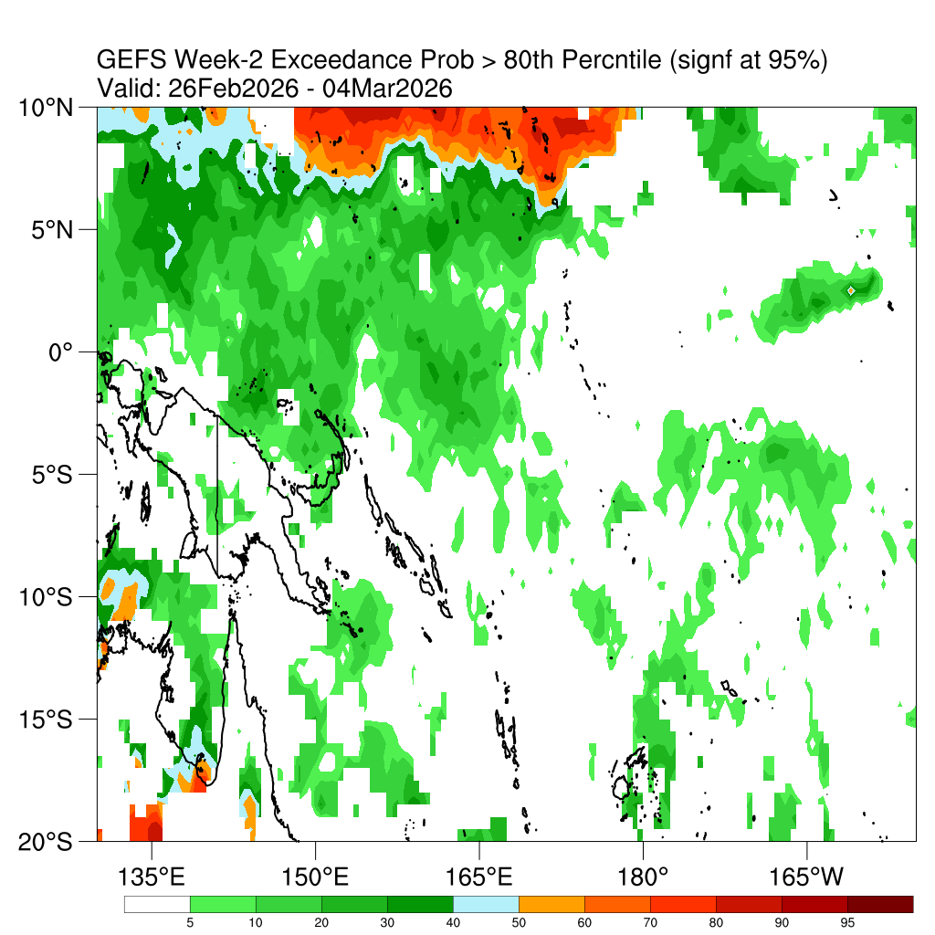
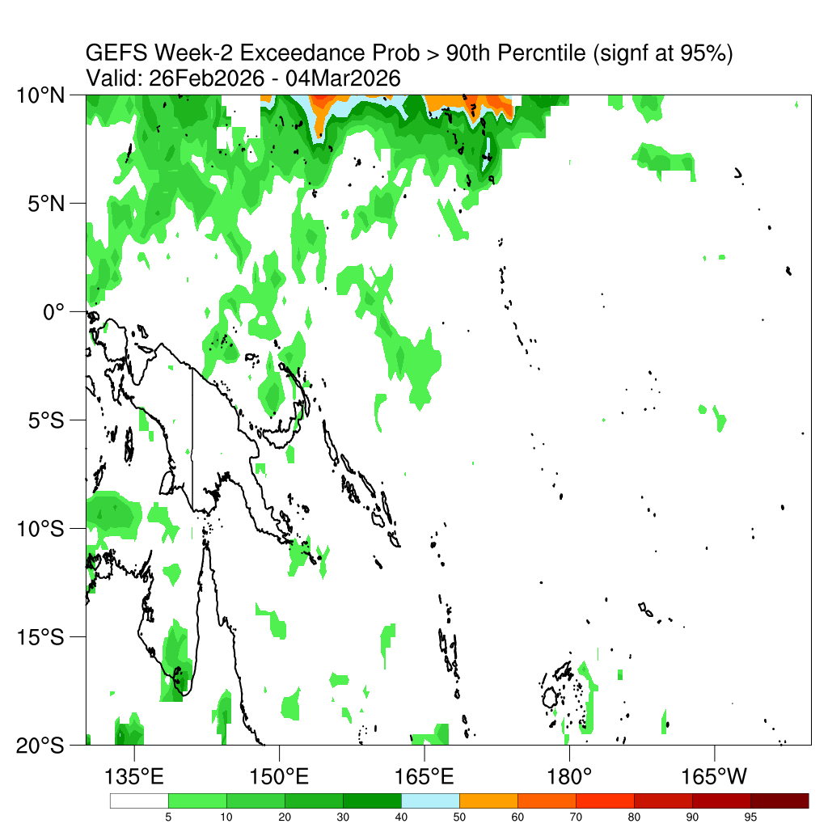
Week-2 GEFS Precipitation/Probability Forecasts (Calibrated)
Rainfall Total (mm)
Rainfall Anomaly (mm)
Precipitation
https://ftp.cpc.ncep.noaa.gov/International/GEFS/cPacific/precGEFSwk2EnsMeanCalib.png
https://ftp.cpc.ncep.noaa.gov/International/GEFS/cPacific/precGEFSwk2AnomCalib.png
PoE for precip exceeding the 80th percentile
PoE for precip exceeding the 90th percentile
Probability of Exceedance (PoE)
https://ftp.cpc.ncep.noaa.gov/International/GEFS/cPacific/wk2precExcd80sig.png
https://ftp.cpc.ncep.noaa.gov/International/GEFS/cPacific/wk2precExcd90sig.png

Slide 11
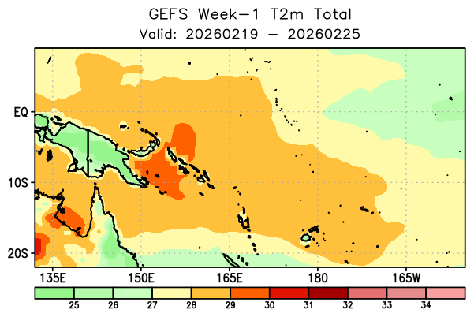
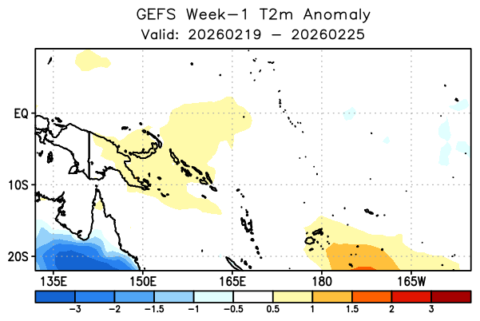
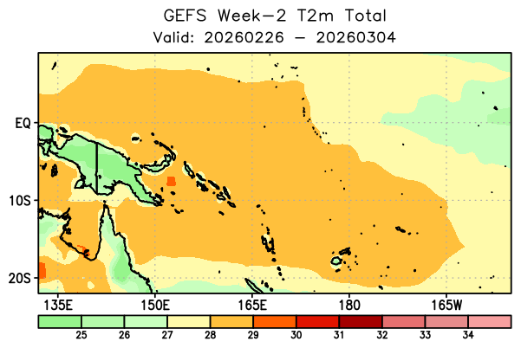
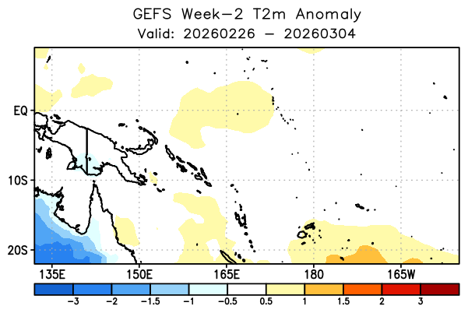
Week 1 & 2 GEFS Temperature Forecasts (without mask)
Average (ºC)
Anomaly (ºC)
Week-1
https://ftp.cpc.ncep.noaa.gov/International/PREPARE_Pacific/subseasonal/gefs_raw_unmasked/gefs_week1_figures/gefs_week1_t2mt.png
https://ftp.cpc.ncep.noaa.gov/International/PREPARE_Pacific/subseasonal/gefs_raw_unmasked/gefs_week1_figures/gefs_week1_t2m.png
Average (ºC)
Anomaly (ºC)
Week-2
https://ftp.cpc.ncep.noaa.gov/International/PREPARE_Pacific/subseasonal/gefs_raw_unmasked/gefs_week2_figures/gefs_week2_t2mt.png
https://ftp.cpc.ncep.noaa.gov/International/PREPARE_Pacific/subseasonal/gefs_raw_unmasked/gefs_week2_figures/gefs_week2_t2m.png

Slide 12
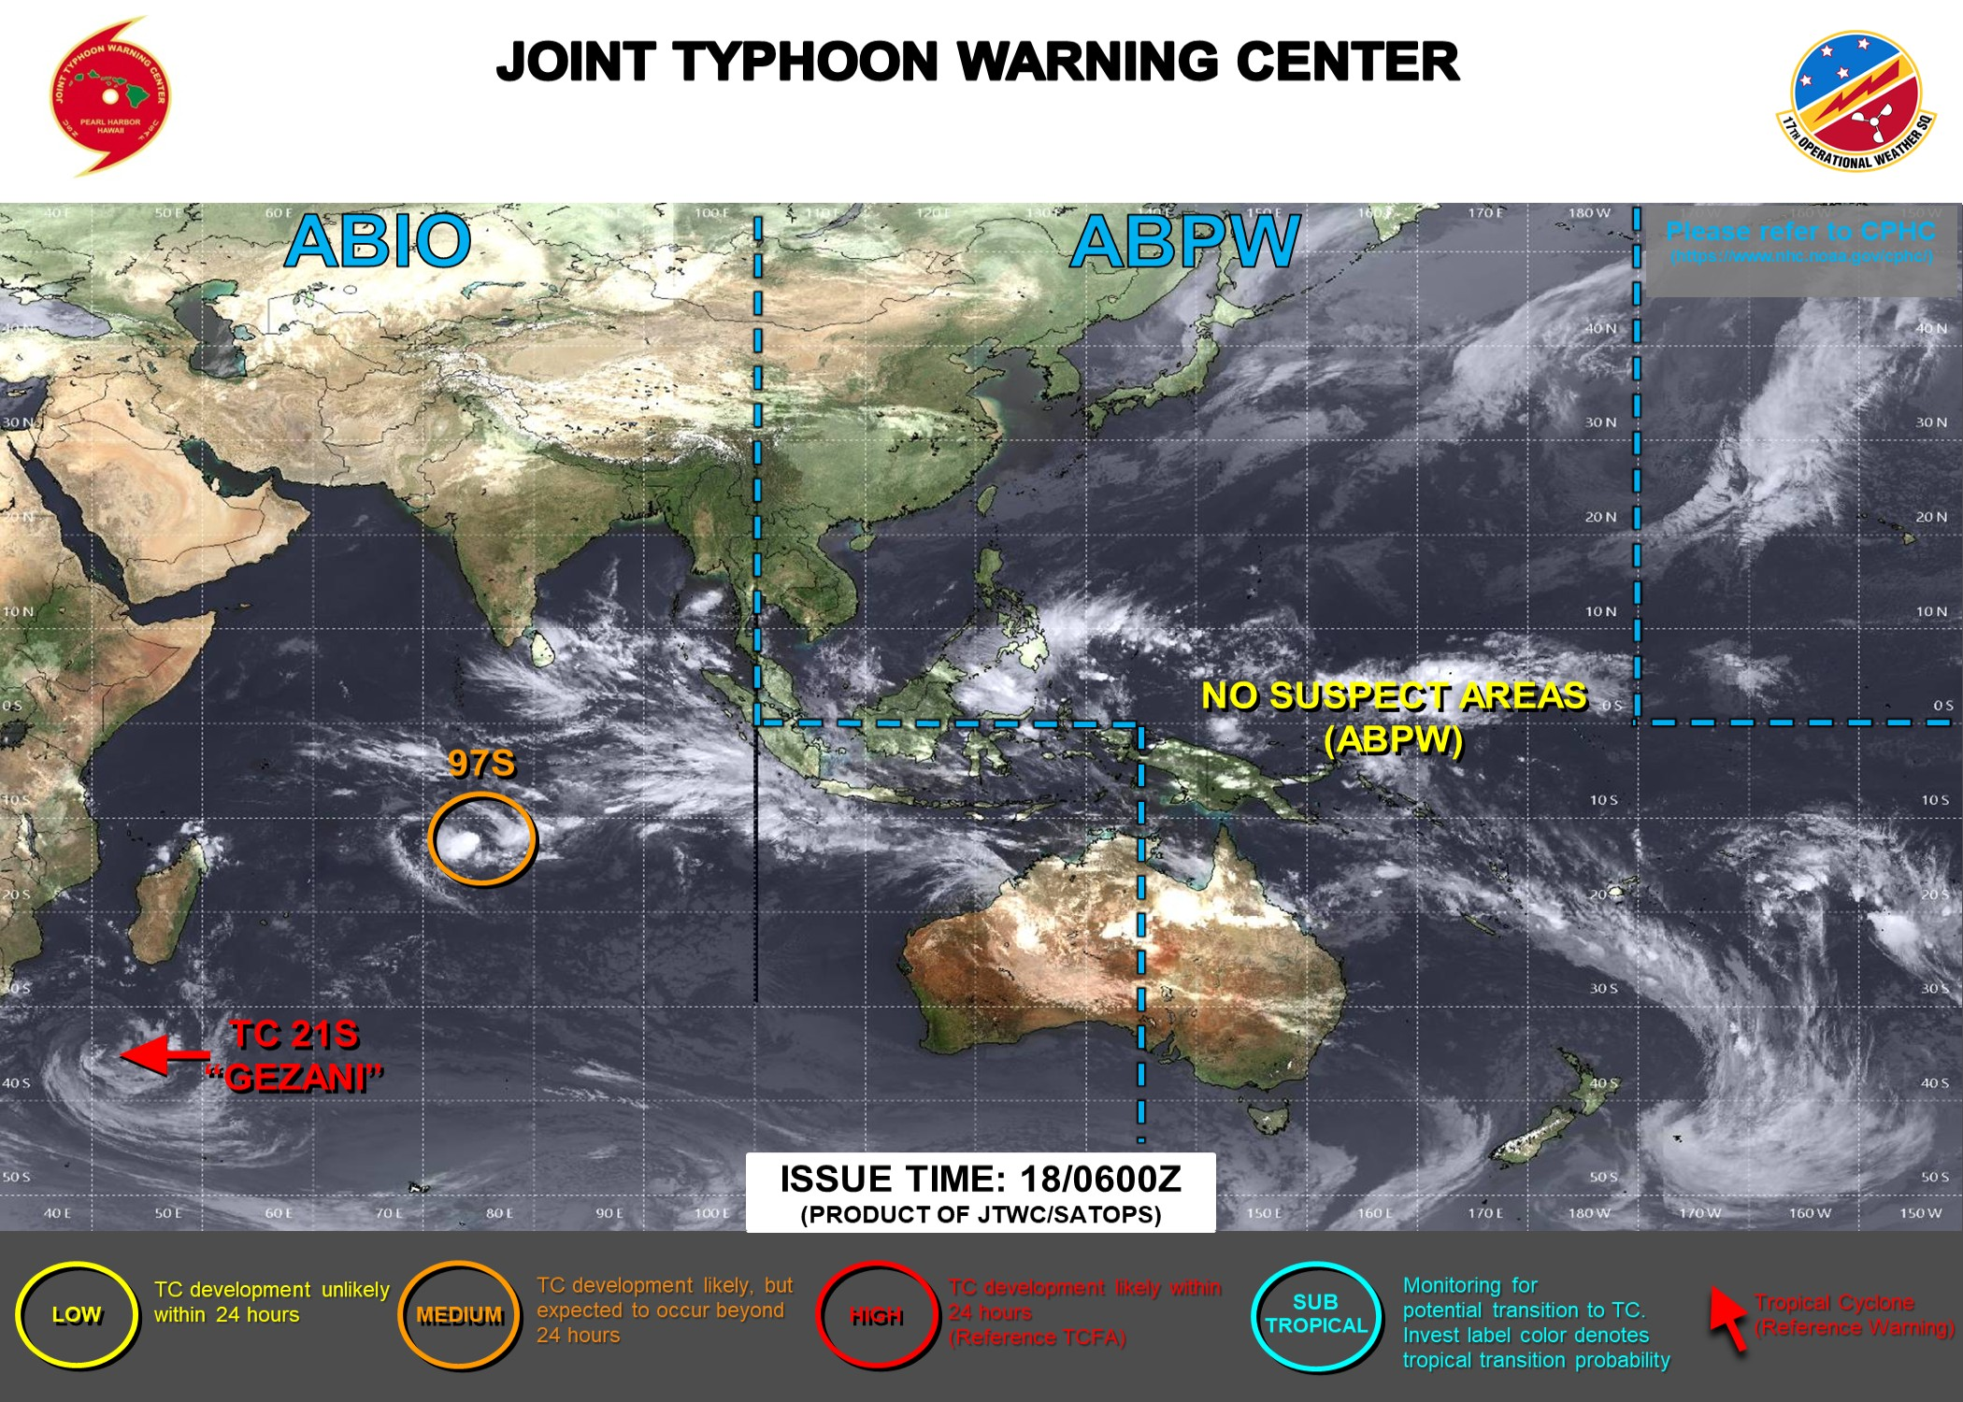
Pacific Tropical Cyclone and Disturbances
No tropical storm is expected in the region of interest.
https://www.emc.ncep.noaa.gov/hurricane/HFSA/index.php
https://www.metoc.navy.mil/jtwc/jtwc.html

Slide 13
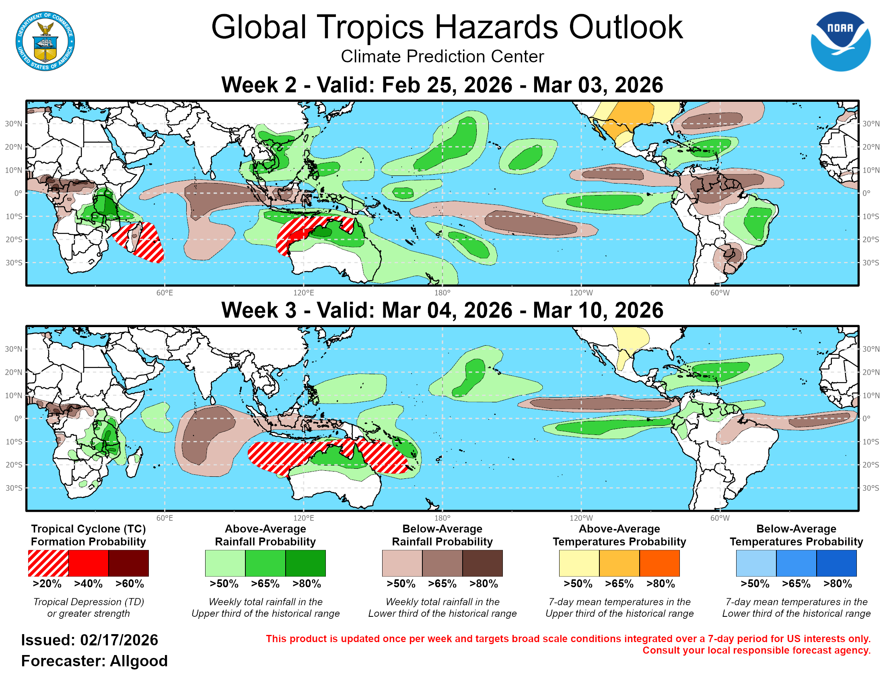
Global Tropical Hazards for Week 2-3
According to the CPC GTH discussion, during Week 2. Above-normal rainfall is expected over eastern Papua New Guinea, New Ireland, New Britain, Solomon Islands and Vanuatu. Below-normal rainfall is likely over the Kiribati area. Tropical cyclone formation is likely south of PNG.
In Week 3, the likelihood of above-normal rainfall continues over Papua New Guinea, New Ireland, New Britain, Solomon Islands, and Vanuatu. Below-average rainfall is also likely over Kiribati Islands and Fiji Islands. Tropical cyclone formation is likely southeast of PNG.
https://www.cpc.ncep.noaa.gov/products/precip/CWlink/ghaz/index.php

Slide 14
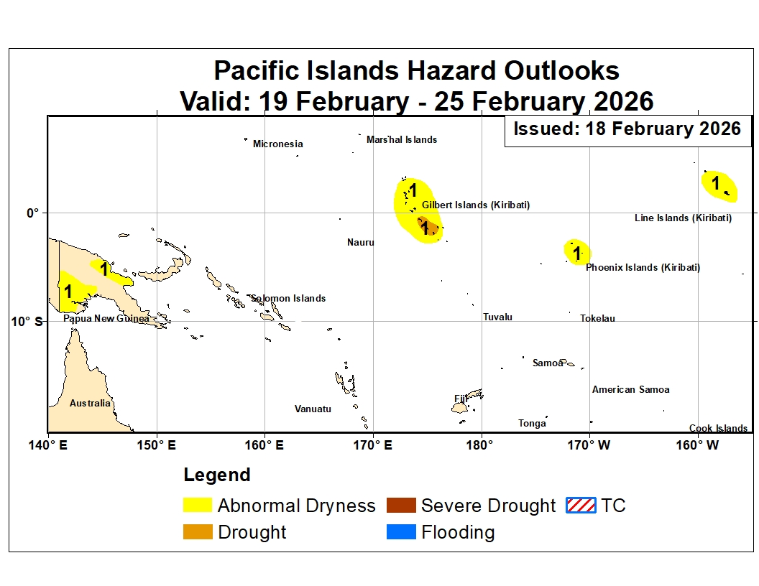
Regional Hazards Outlook
Below to near average rainfall is likely over Central Pacific Region
Over the past week, dry conditions were localized but noticeable in several areas. Fiji showed slight rainfall deficits (about 10–50 mm), particularly over Vanua Levu. Southwestern Papua New Guinea also experienced weekly precipitation shortfalls exceeding 50 mm in some locations. Parts of the northwestern Solomon Islands recorded modest deficits (10–50 mm). During the past month, dryness was uneven across the region. Fiji experienced emerging deficits in the eastern, northwestern, and southern areas following a recent rainfall reduction, though overall conditions remained near normal. In Papua New Guinea, persistent dry conditions continued in Morobe, Madang, and the Western and Southern Highlands, with southwestern areas receiving only about 25–80% of average rainfall. Kiribati still showed localized deficits in parts of the Gilbert and Phoenix Islands, although recent rainfall helped reduce shortfalls. Seasonal dryness was most pronounced in Kiribati and southwestern Papua New Guinea. Over the last 90 days, Kiribati recorded widespread rainfall deficits of roughly 80–240 mm, with many locations receiving less than half of normal rainfall and some islands below 25% of average. Southwestern Papua New Guinea also experienced substantial seasonal deficits in some datasets. In the coming week, widespread dry conditions are expected. However, parts of the Kiribati Islands are currently showing rainfall surpluses, but dry polygons are being kept in place due to the expected dryness next week.
2) Wet conditions during the past week were driven mainly by localized storm activity. Papua New Guinea experienced the heaviest rainfall, with intense storms producing totals of up to 200 mm across northern and southern coastal areas, including parts of the Gulf region and nearby islands. Moderate rainfall also affected southern Solomon Islands early in the week. In Kiribati, scattered storms brought moderate rainfall to parts of the northern Gilbert Islands, contributing to short-term rainfall surpluses in northern Kiribati and the Line Islands. Fiji generally received light to moderate rainfall but remained slightly below average overall. Over the past month, wet conditions were most evident across the Solomon Islands, where persistent rainfall produced large surpluses exceeding 250 mm in several locations, with some central islands receiving more than double their normal monthly rainfall. Fiji also recorded notable rainfall surpluses earlier in the period, particularly across Viti Levu and Vanua Levu, although these were moderated by a recent lull in precipitation. Parts of Kiribati showed modest rainfall surpluses, while central Vanuatu continued to record above-average rainfall, though with decreasing magnitude. Seasonal wet conditions were widespread across Fiji, the Solomon Islands, and parts of Vanuatu. Fiji recorded very large 90-day rainfall surpluses, exceeding 500 mm across Viti Levu and over 1000 mm in parts of Vanua Levu. The Solomon Islands also experienced sustained wet conditions, with cumulative surpluses exceeding 500 mm in central and northern islands due to repeated storm activity. Northern Vanuatu remained wetter than average, with significant seasonal surpluses in provinces such as Malampa and Penama. In the coming week, above-average rainfall is expected over the southwestern and central regions of PNG. The likelihood of rainfall totals exceeding the 80th percentile is low, so significant flood risk is not anticipated during the next week of February 2026.

Slide 15
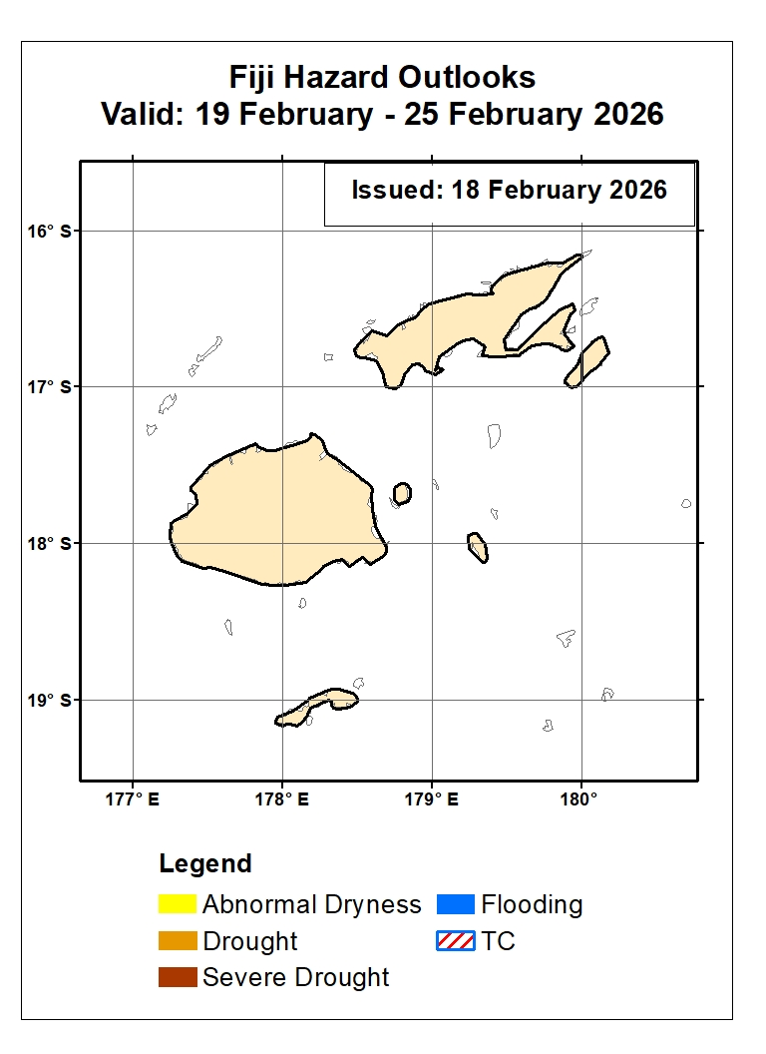
Fiji Hazards Outlook
Near Average weather conditions are likely over Fiji
During the past week, Fiji experienced generally light to moderate rainfall, with several weather systems approaching early in the period. Despite these events, most islands recorded slight rainfall deficits of approximately 10–50 mm. The largest shortfalls were observed over Vanua Levu, where precipitation remained below average according to satellite-based analyses. Overall, short-term conditions across Fiji were slightly drier than normal, although rainfall activity continued intermittently across parts of the country. Over the past 30 days, rainfall conditions across Fiji were mixed. Persistent precipitation during late January and early February produced moderate rainfall surpluses across much of Viti Levu and Vanua Levu, with cumulative anomalies of roughly 70–100 mm above average. However, a recent lull in rainfall reduced these surpluses. It led to the re-emergence of mild deficits across eastern, northwestern, and southern regions, including some outer islands where shortfalls reached about 50–100 mm. Overall, most of the main islands received near-normal rainfall, totaling approximately 80–120% of the climatological monthly average. During the December–January–February period, Fiji remained wetter than average overall. Seasonal rainfall surpluses were substantial across the main islands, exceeding 500 mm in Viti Levu and more than 1000 mm in parts of Vanua Levu. In contrast, northern and southern isolated islands recorded rainfall totals close to normal, with only minor localized deficits. In percentage terms, most of Fiji received about 150–200% of its long-term seasonal average rainfall during the past 90 days.
In the coming week, light to moderate precipitation is expected across most of Fiji.

Slide 16
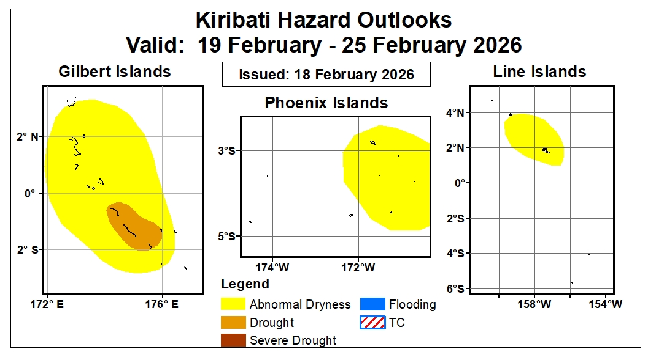
Kiribati Hazards Outlook
Dry conditions expected to persist across Kiribati
During the past week, rainfall across Kiribati was uneven but generally near to above average in several areas. Moderate rainfall associated with scattered, short-lived storms affected parts of the northern Gilbert Islands early in the period, followed by mostly clear conditions across much of the country. Satellite-based analyses indicate rainfall surpluses of approximately 25–100 mm across northern Kiribati and parts of the Line Islands. Overall, short-term conditions were wetter than average in some northern and eastern areas, while other locations experienced relatively dry weather later in the week. Over the past 30 days, rainfall conditions across Kiribati were mixed, with both surpluses and deficits observed. Some stations across the Gilbert and Line Islands recorded cumulative rainfall surpluses of about 10–80 mm. However, localized deficits of up to 80 mm persisted in parts of the Gilbert and Phoenix Islands, including Beru and Canton. Recent rainfall events have helped reduce earlier shortfalls across several islands, resulting in generally near-average conditions across much of the country. During the December–January–February period, Kiribati experienced predominantly drier-than-average conditions. Cumulative rainfall deficits of approximately 80–240 mm were observed across many islands, with several locations receiving less than 50% of their long-term average rainfall. The Phoenix and Line Islands were particularly dry, with seasonal rainfall totals below 25% of normal in some areas. Although occasional rainfall events occurred in early January and early February, seasonal dryness remained widespread across Kiribati.
In the coming week, drier-than-average conditions are expected to persist. As a result, the Abnormal Dryness and Drought polygons remain in place over much of the Gilbert and Line Islands.

Slide 17
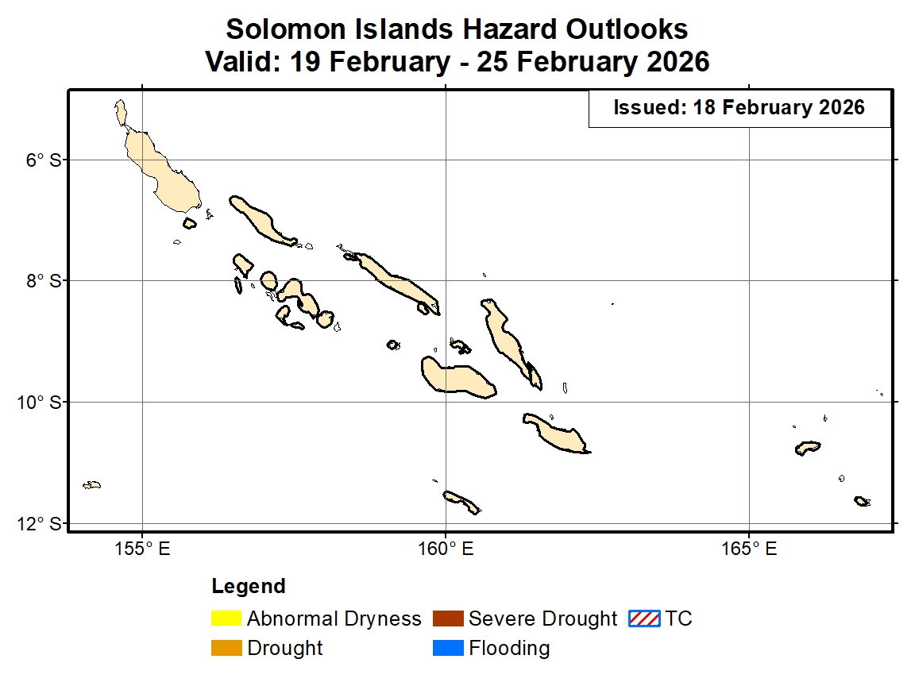
Solomon Islands Hazards Outlook
Solomon Islands are likely to experience dry conditions
During the past week, rainfall across the Solomon Islands was generally near to above average, although some localized dry conditions were observed. Mid-week storms brought moderate rainfall exceeding about 25 mm to parts of the southern islands, including San Cristobal, Malaita, and Guadalcanal. Elsewhere, moderate rainfall occurred across the northwestern islands but was insufficient to fully offset short-term deficits, resulting in localized rainfall deficits of 10–50 mm. Overall, conditions were mixed, with wet conditions in the south and slightly drier conditions in some northwestern areas. Over the past 30 days, the Solomon Islands experienced predominantly wetter-than-average conditions. Persistent rainfall and repeated storm activity produced substantial cumulative surpluses across much of the country. Locations in the Western Province, New Georgia, and Guadalcanal recorded rainfall totals more than 250 mm above average, while even the lowest anomalies exceeded about 100 mm above normal. In percentage terms, the central islands received more than 200% of their long-term average rainfall during the period. During the December–January–February period, wet conditions remained widespread across the Solomon Islands. Continued storm activity produced large seasonal rainfall surpluses, exceeding 500 mm in central and northern islands and ranging between about 100–200 mm above average in southern areas. All monitored locations recorded above-average rainfall, with some sites in New Georgia showing surpluses approaching 600 mm. Overall, most stations received more than 120% of their long-term seasonal rainfall.
In the coming week, below-average rainfall is expected across Solomon Islands.

