Slide 1
The Fiji Sheep and Goat Meat Markets

Slide 2
Notes:
Fiji Samoa mid level countries
Australia 112,000 FJD

Slide 3
Meat Consumption Per Capita Kg/Annum
Country | Beef | Pork | Poultry | Sheep/Goat | Other | Total
Aust | 43 | 23 | 39 | 14 | 1 | 120
NZ | 32 | 23 | 34 | 23 | 4 | 116
World | 9 | 16 | 15 | 2 | 1 | 43
Fiji | 6 | 1 | 19 | 10 | 0 | 36
Samoa | 11 | 22 | 34 | 13 | 0 | 80
 |  |  | 75
Notes:
Fiji relatively low, but half population virtually vegetarian
India lowest meat consumption in world
Samoa chicken consumption probably higher based on imports

Slide 4
Local (Blue) Vs Imported (Red) Supply
Notes:
Fiji relatively self sufficient in meat production.
But not sheep and goats
Samoa imports bushes legs

Slide 5
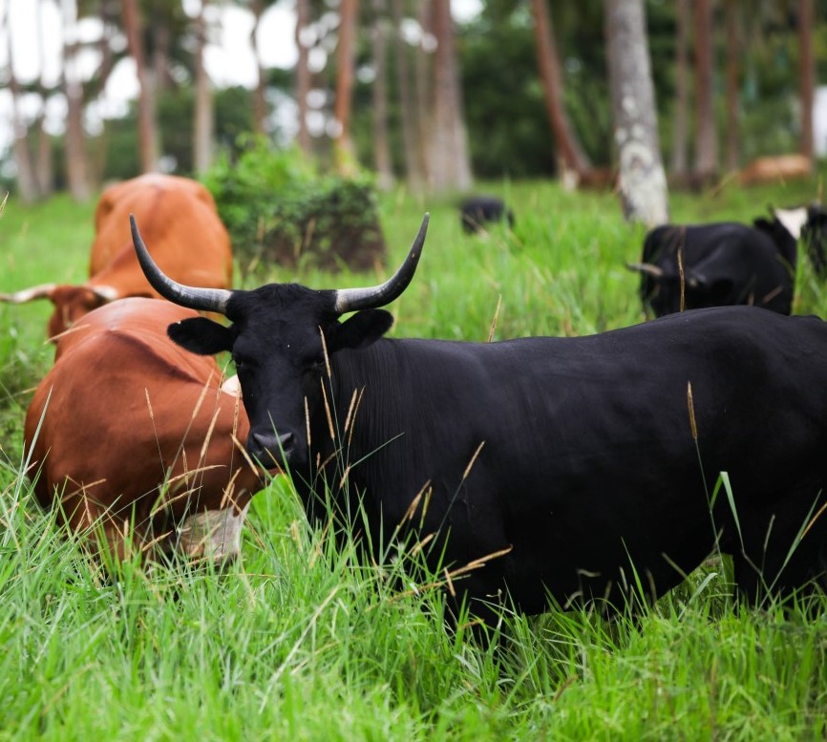
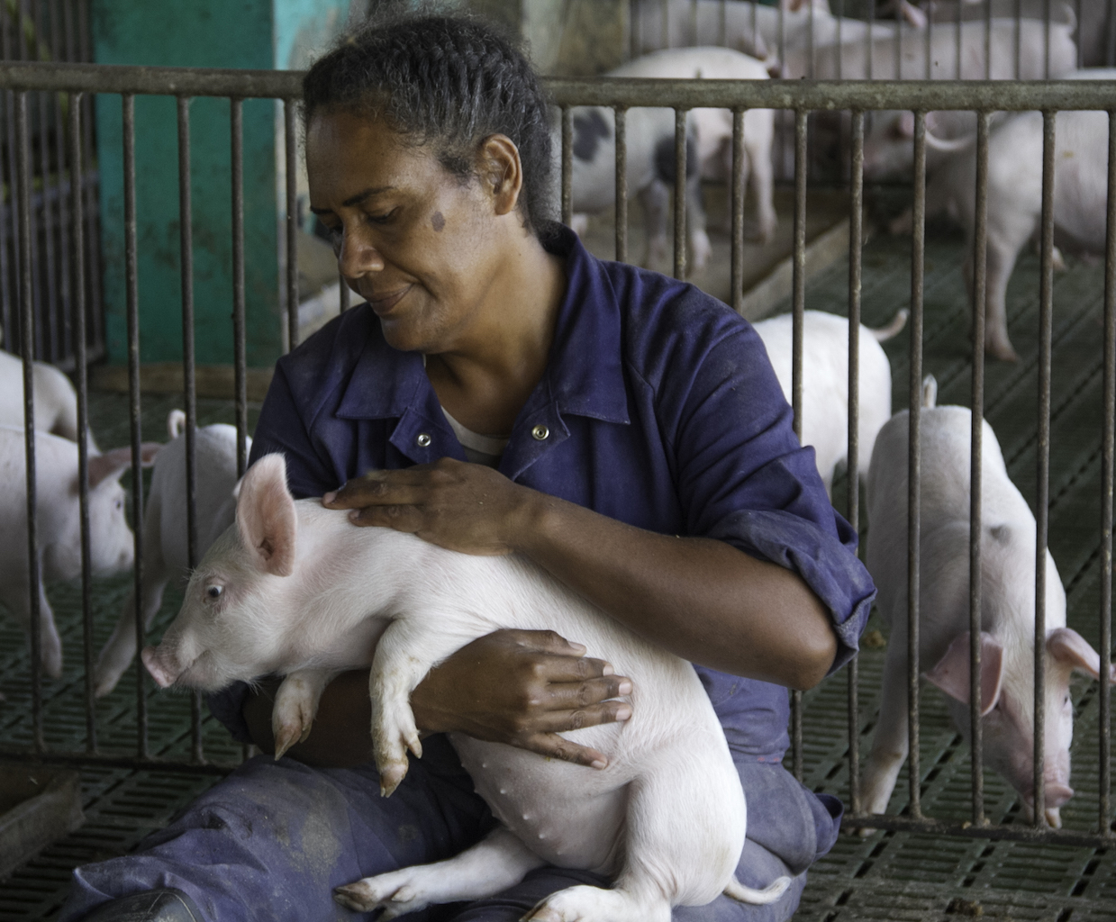
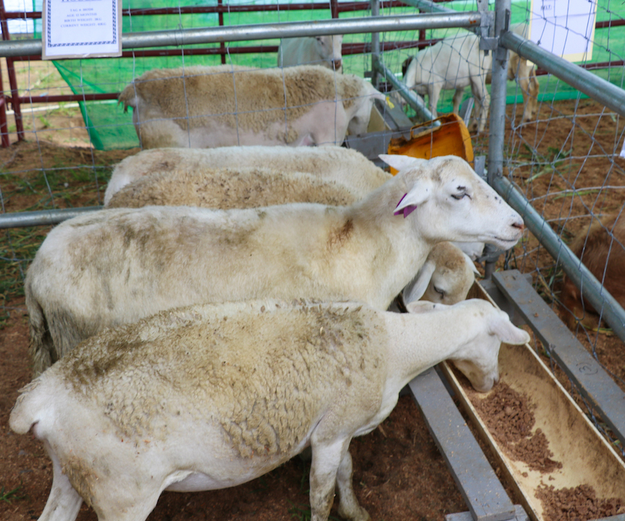

Slide 6
Local Production Tons
 | Chicken | Beef | Sheep | Goats | Pigs
Samoa | 380 | 1,000 | Ins | 0 | 4,182
Fiji | 18,300 | 4,000 | 100 | 615 | 2,200

Slide 7
Head of Sheep and Goat Slaughtered
Notes:
FAO Stat I do not trust these figures
Probably underestimate Goat numbers
Pigs 90,000 per year

Slide 8
Comparative Fiji Meat Retail Prices
Product | Price | Range
Local Sheep meat | 24.95
Lamb Leg | 16.95
Lamb Neck | 11.95 | 16.25
Lamb Shoulder | 19.75
Pork Leg | 12.90 | 23.00
Beef Rump | 15.90
Chicken Whole | 9.02
Chicken Leg | 11.50
Imported Goat Pieces | 15.00
Goat Local | 22.00 | 24.00
Notes:
Prices vary widely post covid
Pork prices most impacted
Goat imported Local goat only on special order

Slide 9
Market Preference for Sheep and Goat Meat
Goat | Preferred meat of the Indo-Fijian community although predominance of vegetarian meals. Goat is regularly used for festive occasions. Used by the Muslim community however high cost generated by demand drives Muslim community to beef. Not liked by ethnic Fijians
Lamb/ Sheep | Accepted by all ethnic communities but preferred by none Has retained market share based on relatively cheap imported offcuts from New Zealand and Australia Lost considerable market share to increasing cheaper poultry supply .

Slide 10
Pricing and Sourcing
Local produce sold in Maqiti market. Short value chain. Price not an issue
Local Sheep and Goat must be a special order at Supermarkets.
Regulatory requirements to move stock for slaughter. (Discouraging)
All Lamb/Mutton imports are off cuts. Local supply can’t compete
Feral NZ goat is the primary source of commercial goat supply.
Import duty set at 15%
50% Sheep from Aust and NZ respectively.
Imported directly by supermarkets. Short value chain.

Slide 11
GOAT VALUE CHAIN IN FIJI
ARROW SIZES REPRESENT VOLUME/VALUE FLOWS
HOUSEHOLD/MAQITI MARKET
620 tonnes
RETAIL
40 tonnes
FOOD SERVICE
2 tonnes
CONSUMER MARKET
F13 MILLION
620 tonnes
42 tonnes
RETAIL
VALUE ADD F1 MILLION
MARKET MECHANISM
F12 MILLION
HOUSEHOLD / MAGITI MARKET
FMIB/
WHOLESALER
WHOLESALER
ABATTOIR & DELIVERY
VALUE ADD F1 MILLION
600 tonnes
30 t
5 t
25t
SUPPLY
660 TONNES
F11 MILLION
SMALLHOLDERS
10,000 FARMS
100,000 GOATS
10 GOATS/FARM
SMALL COMMERCIAL
20 FARMS
3,000 GOATS
150 GOATS/FARM
LARGE COMMERCIAL
1 FARMS
500 GOATS
500 GOATS/FARM
IMPORTS
BONEIN FROM AUS & NZ
FLOCK MULTIPLICATION
Notes:
94% of Goat Sold informally
Only 6% sold through formal
Pig industry has moved magiti into the formal sector through convenience.

Slide 12
SHEEPMEAT VALUE CHAIN IN FIJI
ARROW SIZES REPRESENT VOLUME/VALUE FLOWS
TOURISM
200 tonnes
HOUSEHOLD/ MAQITI
100 tonnes
RETAIL
4.800 tonnes
FOOD SERVICE
200
CONSUMER MARKET
F70 MILLION
100 t
50 t
450 tonnes
4,500 tonnes
RETAIL
VALUE ADD F13 MILLION
LAMB CUTS
PROCESSED
MARKET MECHANISM
F57 MILLION
HOUSEHOLD / MAGITI MARKET
FMIB
PROCESSOR/ WHOLESALER
IMPORTER/ WHOLESALER
WHOLESALE/
PROCESS
VALUE ADD F7 MILLION
66 t
30 t
6 t
5,000 tonnes
SUPPLY
5,100 TONNES
F50 MILLION
SMALLHOLDERS
800 FARMS
11,000 SHEEP
14 SHEEP/FARM
SMALL COMMERCIAL
4 FARMS
2,000 SHEEP
500 SHEEP/FARM
LARGE COMMERCIAL
1 FARMS
1,000 SHEEP
1,000 SHEEP/FARM
IMPORTS
FROM AUS & NZ
FLOCK MULTIPLICATION

Slide 13
Sheep and Goat Meat Quality Standards Is this a problem?
There are currently no official sheep or goat grade standards in Fiji.
3 carcass types can suggested. Prime, Average, Lean Based on muscle cover
Most sheep in Fiji are often under muscled
This is a result of poor growing conditions and genetics.
Poor carcass confirmation and firm meat is expected, even preferred in the local market
A second category could be fat, but few sheep in Fiji tend to fat
Others could be Breed type or Age.
Notes:
Prime :- carcasses which have a superior meat type conformation without regard to the presence of fat cover. They shall be thickly muscled throughout the body as indicated by a pronounced (bulging) outside leg (biceps femoris and semitendinosus), a full (rounded) back strip (longissimus dorsi), and a moderately thick outside
shoulder (triceps brachii group).
Average :- carcasses which have an average meat type conformation without regard to the presence of fat cover. They shall be moderately muscled throughout the body as indicated by a slightly thick and a slightly pronounced outside leg (biceps femoris and semitendinosus), a slightly full (flat or slightly shallow) back strip (longissimus dorsi), and a slightly thick to slightly thin outside shoulder (triceps brachii group). iii) Selection No.
Lean :- carcasses which have an inferior meat type conformation without regard to the presence of fat cover. The legs, back, and shoulders are narrow in relation with its length and they have very angular and sunken appearance.

Slide 14
Sheep SWAT Analysis
STRENGTHS Good health status of sheep herd. The “Fiji Fantastic” breed. Religiously acceptable meat to all sectors Large unsatisfied demand for sheep meat in the Maqiti sector | WEAKNESSES Small numbers of the “Fiji Fantastic” breed Dispersed locations of sheep producers. Uncertainty in the quality of local sheep meat
OPPORTUNITIES Potential for the “Fiji Fantastic” for high value quality lamb cuts. Potential to improve farmer returns/price through management (particularly for internal parasites). | THREATS Animal disease outbreak Theft of animals

Slide 15
Goat SWAT Analysis
STRENGTHS Reasonable health status of national goat herd. Good market demand in the Maqiti sector for supply to the Indo Fijian community. | WEAKNESSES Inefficient goat production based on low input/low output farming. Lack of good market information in Maqiti market. Insufficient treatment for internal parasites Lack of application of business principles to goat production.
OPPORTUNITIES Potential to improve farmer returns (Management) Improvement in animal health management (particularly for internal parasites). Opportunity to use genetics to improve production and quality | THREATS Animal disease outbreak Theft of animals Collapse of Maqiti market

Slide 16
Vinaka

